Slide 1
Fund Update & Small Business Assistance Program Plan
April 2020

Slide 2
SMC Strong Funds Distribution Plan for Initial Measure K Allocation
Recipient | Amount
COVID-19 Emergency Financial Assistance Program for Individuals and Families through 8 Core Services Agencies | $1,000,000
PHASE I: COVID-19 Financial Assistance to Non-Profits for Increased Demand 8 Core Services Agencies 7 Homeless Shelter Providers | $1,000,000
COVID -19 Small Business Assistance Grants of up to $10,000 ($1,000,000 = 100 grants) | $1,000,000
TOTAL County Measure K Contribution | $3,000,000

Slide 3
Ongoing Fundraising Efforts for San Mateo County
Silicon Valley Community Foundation
COVID-19 Regional Response Fund (individuals & families in 10 county region)
Regional Nonprofit Emergency Fund (San Mateo & Santa Clara counties)
San Mateo County Strong Fund
Individuals & Families
Non-Profits
Small Business Grants
All funding stays in San Mateo County
City participation in San Mateo County Strong Fund
City participation in self-implemented grant and loan programs

Slide 4
Financial Assistance Options (Non-Business)
Individuals & Families
Silicon Valley Community Foundation COVID-19 Regional Response Fund (individuals & families in 10 county region)
San Mateo County Strong Fund through Core Services Agencies
Non-Profits
Silicon Valley Community Foundation Regional Nonprofit Emergency Fund (San Mateo & Santa Clara counties)
San Mateo County Strong Fund through Core Services Agencies and Homeless Providers

Slide 5
$484 Billion in New Federal Pandemic Relief
$320 billion to replenish the Paycheck Protection Program, which offers guarantees for forgivable loans to small businesses if a majority of the money is used to retain employees
About a fifth of the funding for the small-business loan program, $60 billion, would be set aside for smaller lenders
$60 billion for the Small Business Administration’s disaster relief fund — divided into $50 billion in loans and $10 billion in grants
$75 billion for hospitals
$25 billion for coronavirus testing

Slide 6
California Portal for Pandemic Unemployment Assistance
As part of the federal CARES Act, the new Pandemic Unemployment Assistance (PUA) program helps unemployed Californians who are:
Business owners
Self-employed
Independent contractors (have limited work history, and others not usually eligible for regular state UI benefits who are out of business or services are significantly reduced as a direct result of the pandemic)
The provisions of the program once operational include:
Up to 39 weeks of benefits starting with weeks of unemployment beginning February 2, 2020, through the week ending December 26, 2020*, depending on when you became directly impacted by the pandemic.
An additional $600 to each PUA weekly benefit amount you may be eligible to receive, as part of the separate CARES Act Pandemic Additional Compensation program. Only the weeks of a claim between March 29 and July 25* are eligible for the extra $600 payments.
– Application portal opens April 28, 2020 – Payments will be processed within 24 to 48 hours
https://www.labor.ca.gov/pandemic-unemployment-assistance-pua-program/

Slide 7
SMC Strong Small Business Grant Program
Grants up to $10,000
$1 million = 100 Grants
Grants can pay for payroll, operations, ongoing expenses or other costs associated with COVID-19 impacts
Partnering with San Mateo Credit Union Community Fund
Funds distributed to all cities and unincorporated area based on population for Measure K funds
Funds distributed based on donor targeting for city funds
Other funding models based on donor choice
No citizenship requirement
- Application opening goal - Monday, April 27th at 12:00pm
www.smcstrong.org

Slide 8
Small Business Eligibility Criteria
Be a for-profit company with at least two employees (owner counts as one employee)
Have a current business license (if required by jurisdiction)
Have an office, storefront or business space that is open to the public in San Mateo County
Has the equivalent of 10 or fewer
full-time employees as of 2/15/20 --- OR --- less than $2.5 million in annual gross revenue over past year
Have been open at least a year
Demonstrate a 25% reduction in gross revenue due to COVID-19

Slide 9
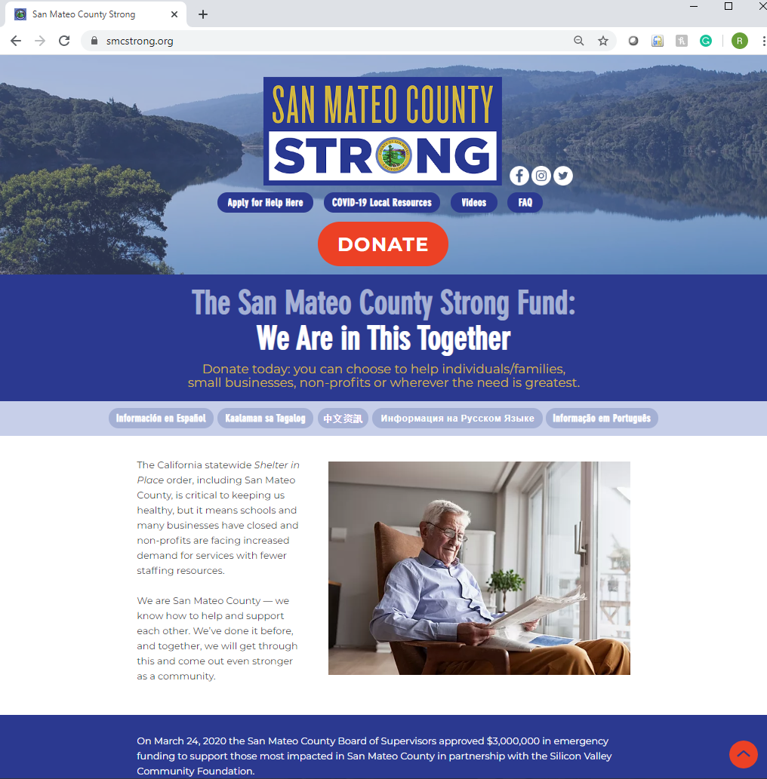
Online Application Process
Available in English, Spanish and Chinese on www.SMCStrong.org
Documentation required for all eligibility criteria Start gathering documents now!
Needed documents may include:
Valid business license
Bank Statements
Current Profit and Loss Statements
IRS or FTB tax returns
Proof of rent or mortgage, utility, healthcare premiums or payroll processing document
Applications only accepted online to comply with physical distancing orders
Detailed FAQ will be posted on website
Call 211 for more information
- Application Opening Goal - Monday, April 27, 2020 at 12:00pm on: www.smcstrong.org

Slide 10
Process for Reviewing Applications and Awards
1
Applications reviewed by San Mateo Credit Union Community Fund staff for eligibility
2
Eligible applications forwarded to the County for final review
3
All eligible applications funded in order of receipt
4
Grants will be allocated based on source of funding: countywide by population for Measure K, geographic constraints for city-specific funds, etc.
5
When funding is exhausted, applications deemed eligible remain in queue in case there is additional funding
6
Grants issued by SMCU Community Fund

Slide 11
Additional Funding for City - Specific Small Business Grants thru SMCSF
Cities - Pledges to Date
Burlingame: $500,000
Colma: $15,000
Redwood City: $300,000
San Carlos: $112,500
San Mateo: $400,000
Under Consideration:
Atherton
Woodside
Informational Presentations
Belmont (planned)
Daly City (planned)
East Palo Alto
Menlo Park (planned)
Millbrae (planned)
Pacifica
San Bruno

Slide 12
Grant Program Outreach and Awareness
Social Media
SMC Strong Webpage
Chambers of Commerce
Ethnic Business Groups
Earned Media
Cities/Town

Slide 13
We Need Your Help to Inform Small Business Owners
Social Media & Email
www.SMCStrong.org
Chambers
Post on FB, Twitter, Instagram, and Nextdoor and send e-blasts – especially sites that help target diverse business owners
Like and link SMC Strong Fund’s new social media sites:
Facebook: http://facebook.com/SMCStrong
Instagram: SMCStrongFund
Twitter: @SMC_Strong
Updated information will be added:
Eligibility
How to apply for SB Grants and prepare documents
Frequently Asked Questions
Link will be added with application portal is opened
Post on FB, Twitter, Instagram, and Nextdoor and send e-blasts
Ask elected officials to push similarly
Inform your members who are likely eligible
Is your City hall information number equipped to provide multi-lingual information and direct to www.SMCStrong.org and 211
Do you have professional members who can help applicants?
Ethnic Groups
Earned Media
County/Cities/Towns
Post on FB, Twitter, Instagram, send e-blasts & inform ethnic media
Inform your members who are likely eligible
Is your City hall information number equipped to provide multi-lingual information and direct to www.SMCStrong.org and 211
Do you have professional members who can help applicants in multiple languages?
Ask your local newspapers, blogs, etc. to cover the details of the grant and application program
Especially ethnic media coverage
Community FB sites
Patch sites
Other ideas
Clerks post on FB, Twitter, Instagram, and Nextdoor and send e-blasts
Ask elected officials to push similarly
Inform your business license holders who qualify and business districts
City hall information numbers equipped to provide multi-lingual information and direct to www.SMCStrong.org and 211

Slide 14
Questions
???

